Slide 1
25 – Clean Code – Design Patterns
Based on the CleanCoders videos by Uncle Bob Martin
Rupert Waldron

Slide 2

So What is a design pattern?
A design pattern is a named solution to a problem in a context
Naming the pattern helps developers discuss solutions to a design problem
Types of Patterns:
Creational Patterns – help create instances of objects
Structural Patterns – help set up the communication pathways between separate groups of objects
Behavioural Patterns – help you partition the behaviours of your system into discrete patterns.
GOF Book

Slide 3
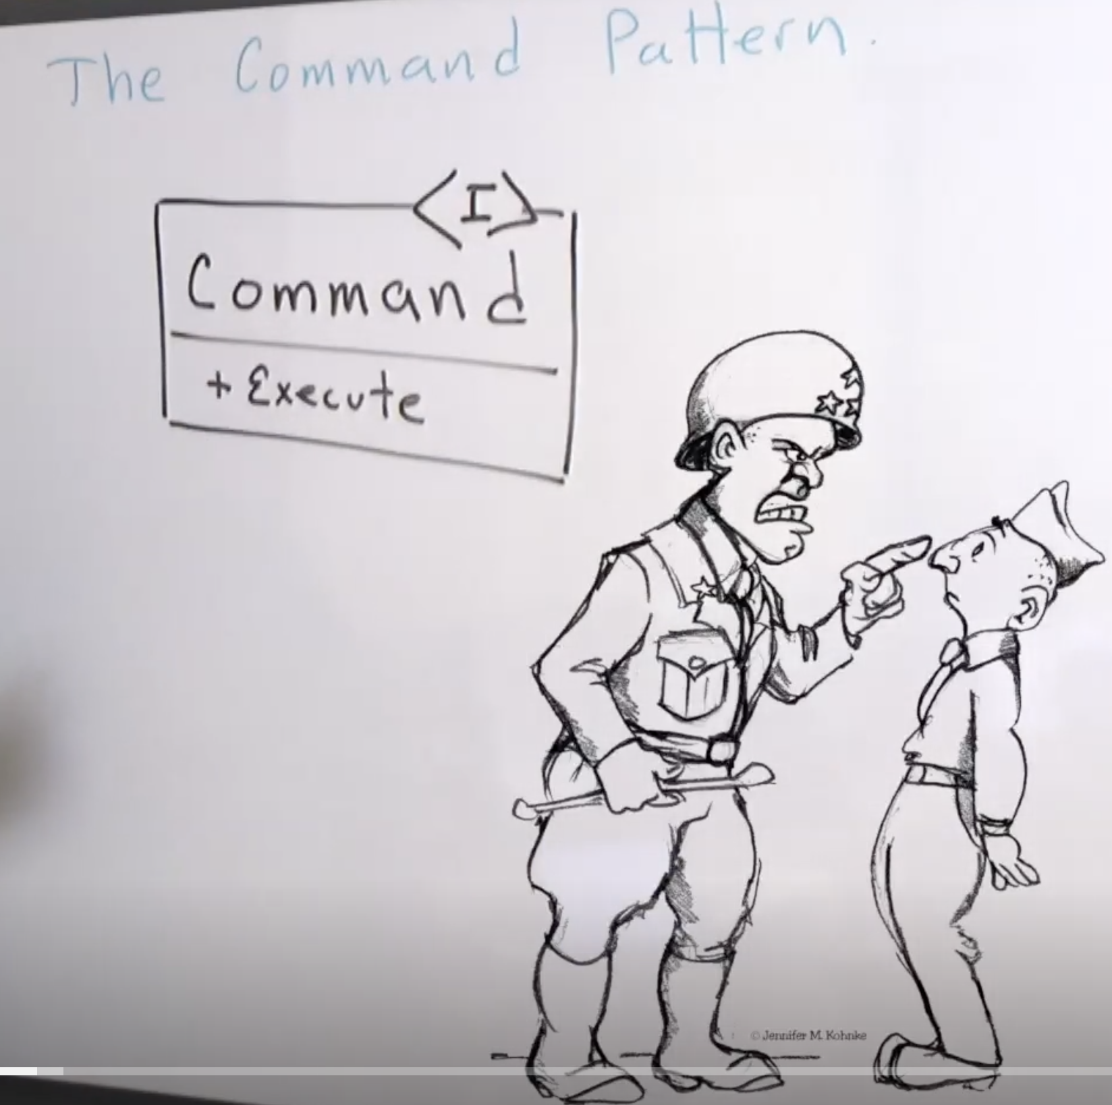
The Command Pattern
The command pattern is a way of coupling what is done from who does it.
It can decouple what gets done from who does it – special decoupling. And also you can store commands objects in an array and execute them at a specific time – temporal decoupling.

Slide 4
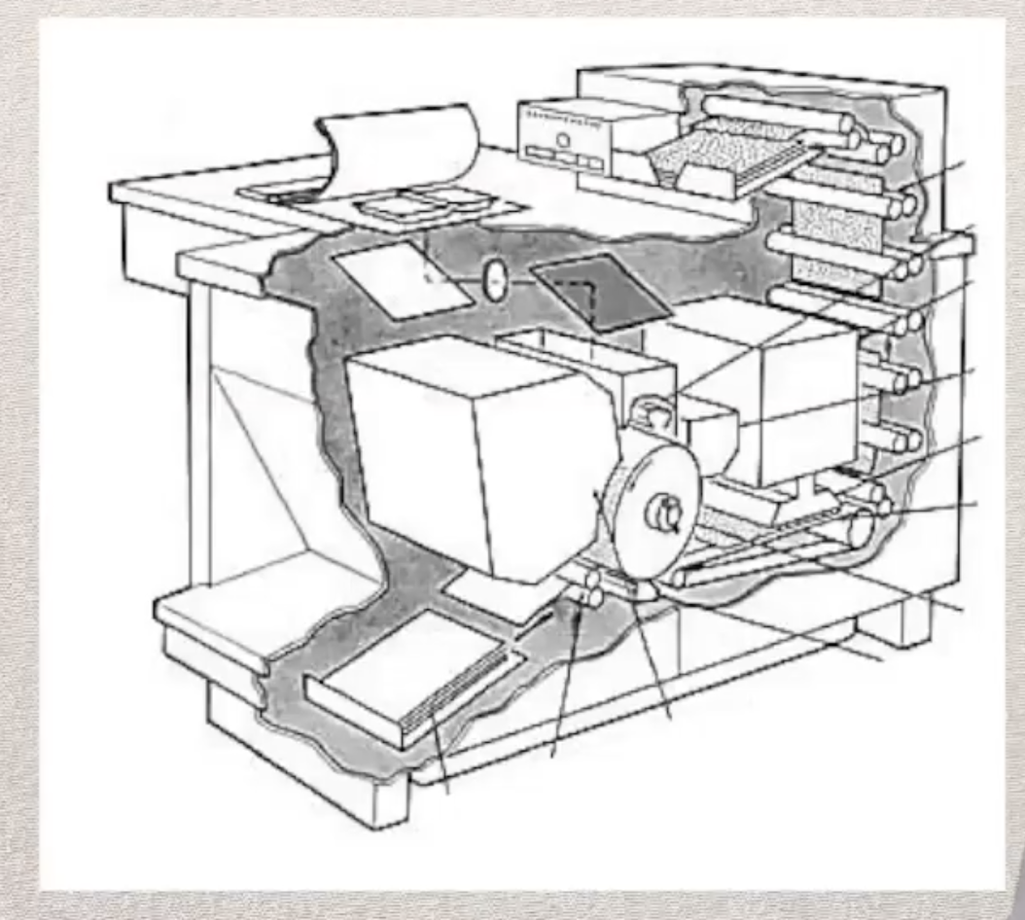
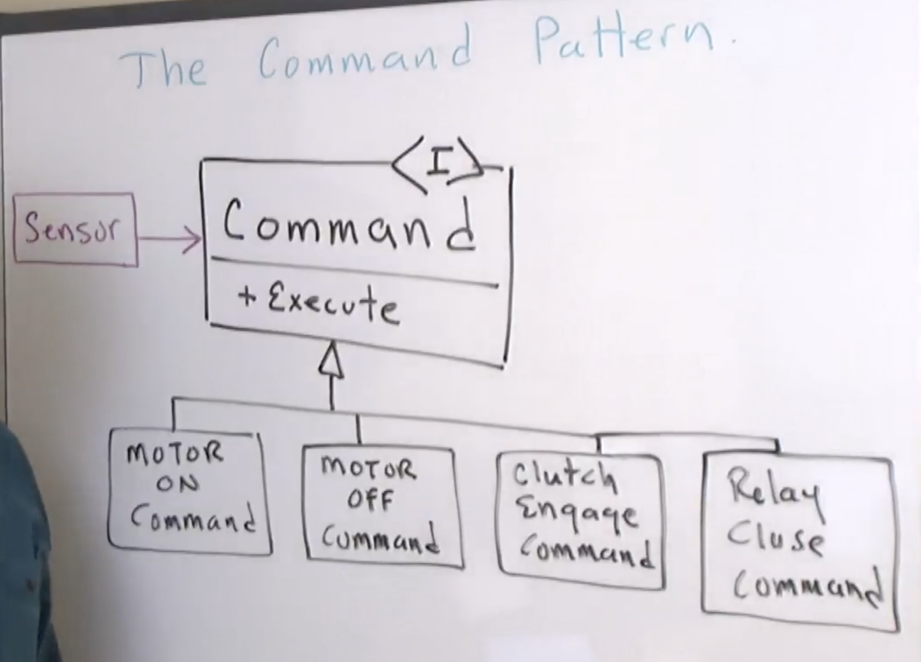
Xerox colour copier example
Lots of motors to control
Every time the sensor is tripped the exectute() method on the command object is called
Sensor contains a command object
The sensor knows nothing about the type of device it is controlling
The Command Pattern is a great way of de-coupling what is done from who does it

